Slide 1
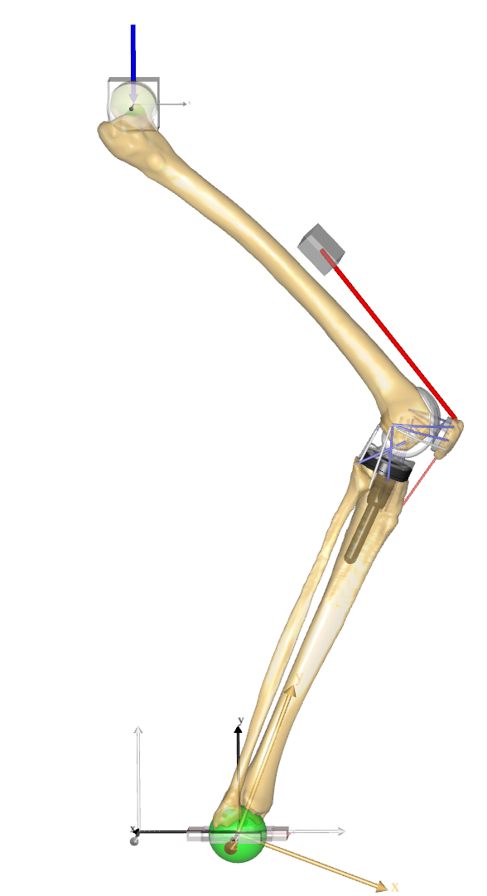
External Load
Hip slider segment
Quadriceps actuator
Femur segment
Patella segment
Tibia segment
Ankle slider segment

Slide 2
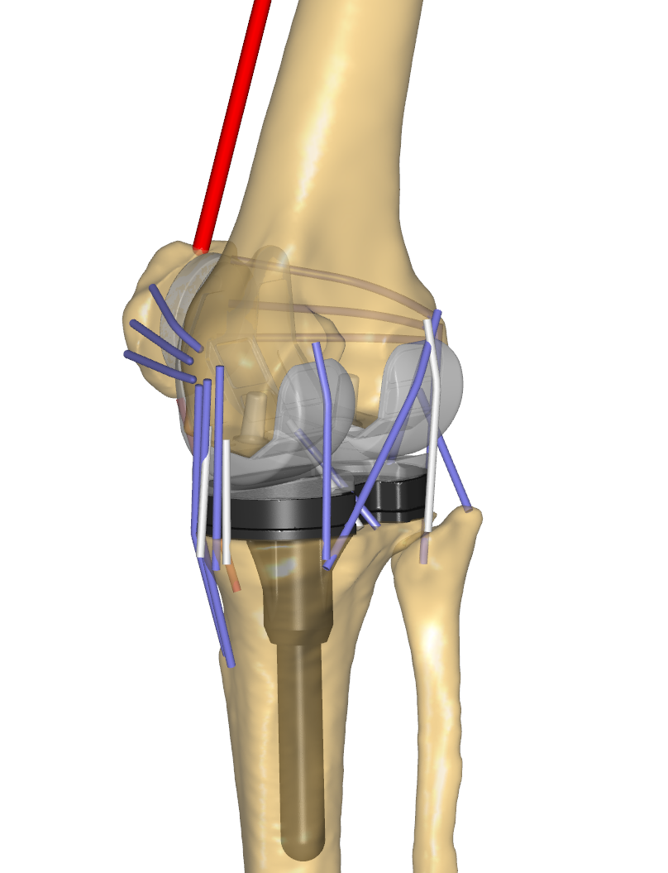
sLPFL
sMPFL
mLPFL
mMPFL
iLPFL
LCL
iMPFL
Mcap
aCM
OPL
pCM
PFL
aPCL
pPCL
pMCL
Lcap
aMCL
cMCL

Slide 3
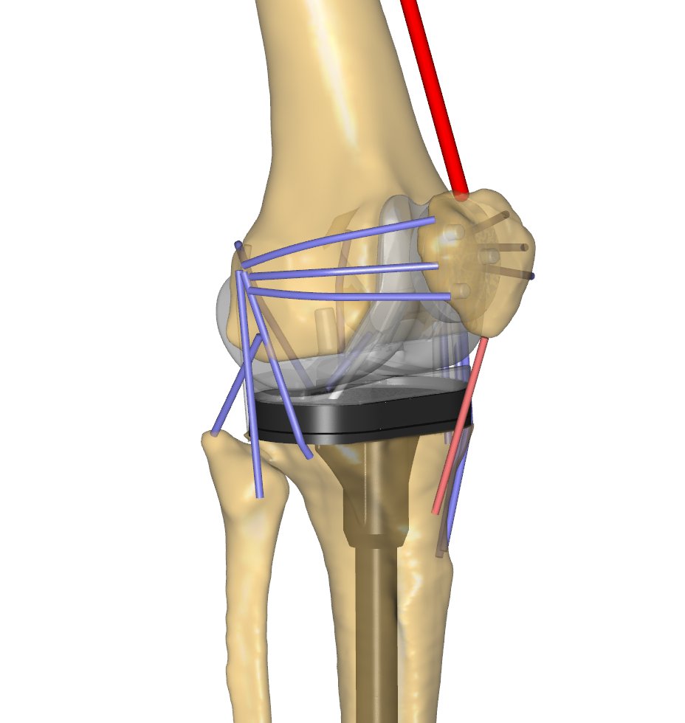
Patellofemoral contact
Lateral
Tibiofemoral
Contact
Medial
Tibiofemoral
Contact

